Slide 1
Data Analysis of Top Music Genres
Ruth Holliday, Austin Little, Gina Kim, Nathalie Longstreet,
Minqiu Yu & Kimberly Gordon

Slide 2
Why was this topic chosen?
Why did we pick this topic?
Our Proposal
Our Hypothesis
Music brings people of all cultures and ethnicities together. Therefore, we wanted to explore the trend of the music industry analytically.
Analyze which genres in the US region took over the top 100 charts over the last 6 years.
GOAL → Create a visual of the trend for the different genres.
The music genre, rap, took over popularity at a faster rate in comparison to other genres and currently holds the highest popularity.
Notes:
Touch on what motivated us to pick this topic. Why we decided to focus on the trend of rap music for our hypothesis.

Slide 3
Questions
What is the most popular music genre in the US today?
By year, what are the top music genres?
Will tracking the popularity of music genres predict its future?
How do the US charts compare to the global charts?
Notes:
Describe whether you were able to answer these questions to your satisfaction.

Slide 4
Data Exploration & Clean-up Process
6. Frequency distribution bar charts were created.
This helped visualize the main genres with its most frequently listed sub-genres.
7. Created a dataframe with the main genres.
Used a stacked bar graph to show the main music genres along with the respective sub-genres.
Saved all of the charts into PNG files.
Explored API’s to obtain the genres.
Spotify’s API → Spotipy
Wikipedia’s US Top 100 Billboard charts:
extract CSV files.
The data was split by year starting from 2012-2017.
Separate Jupyter notebooks.
Created dataframes:
Appended the Spotipy API with the csv file
columns for the Title, Artist(s), and Genre
Created a visualization of the top genres per year.
Multiple sub-genres were found.
Notes:
Run through a jupyter notebook
Discuss insights you had while exploring the data that you didn't anticipate
Multiple subgenres were used to describe each song.
Discuss any problems that arose after exploring the data, and how you resolved them
The spotpy api was a bit cumbersome
Present and discuss interesting figures developed during exploration, ideally with the help of Jupyter Notebook

Slide 5
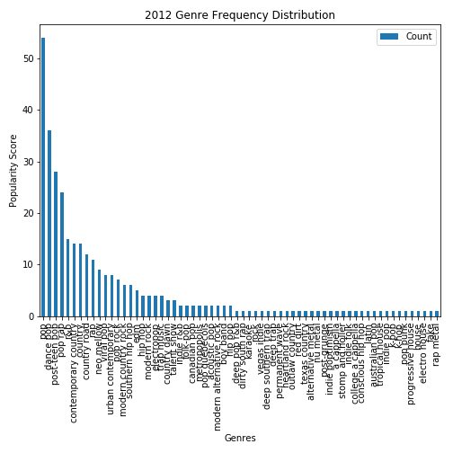
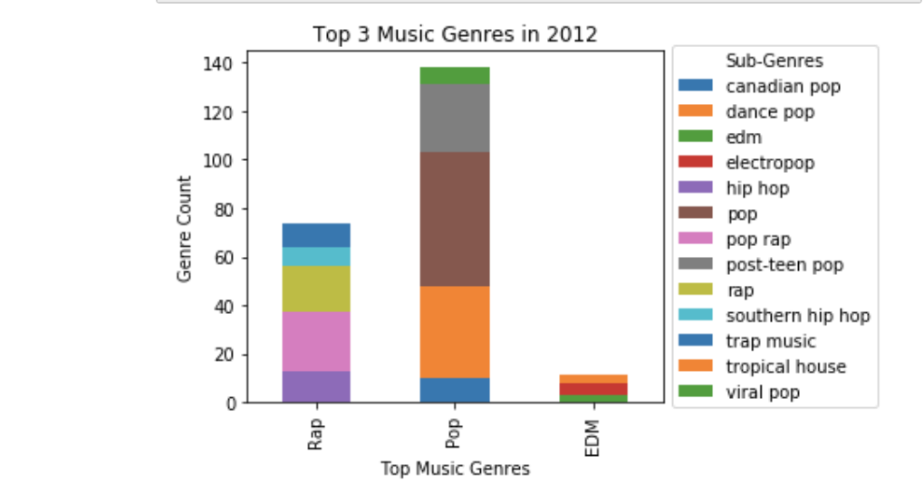
Billboard Top 100 2012

Slide 6
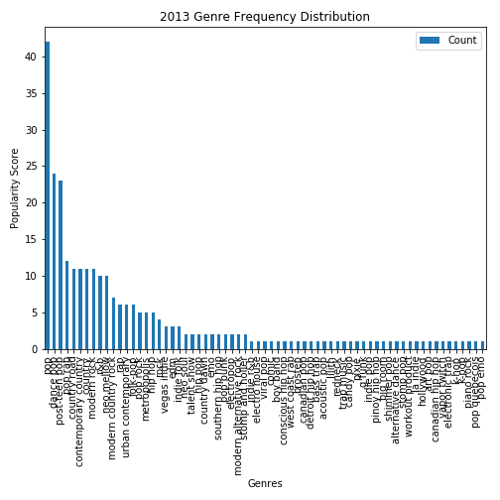
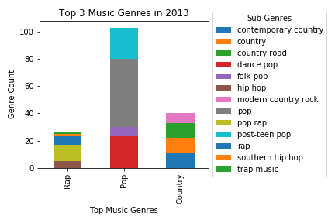
Billboard Top 100 for 2013

Slide 7
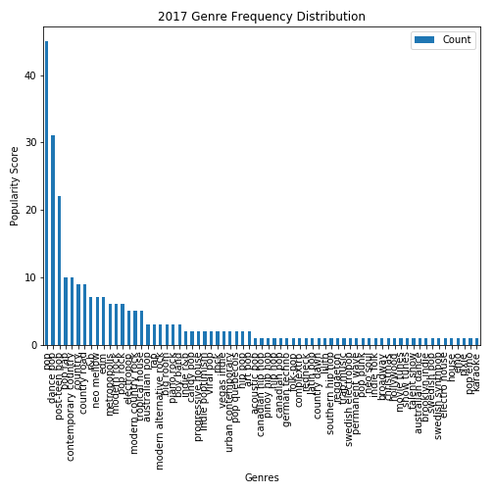
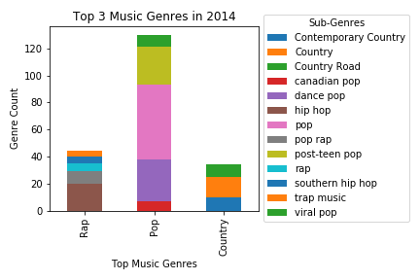
Billboard Top 100 for 2014

Slide 8
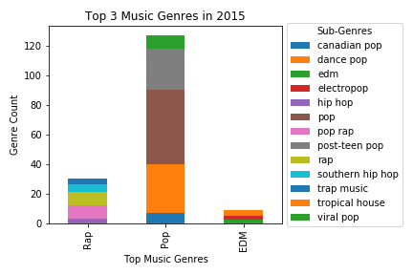
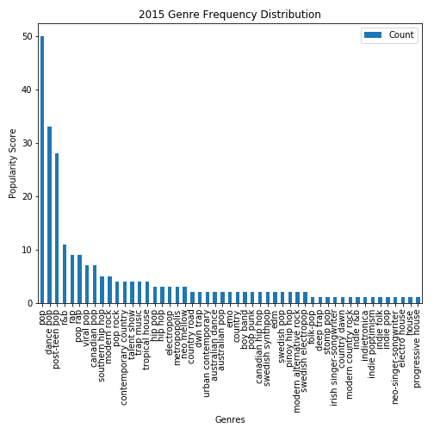
Billboard Top 100 2015

Slide 9
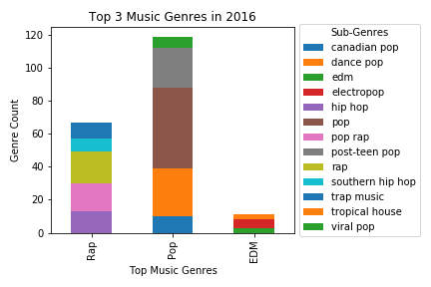
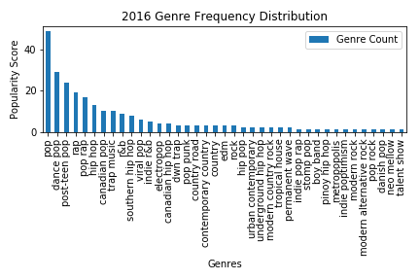
Billboard Top 100 for 2016

Slide 10
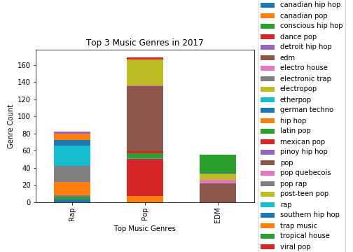
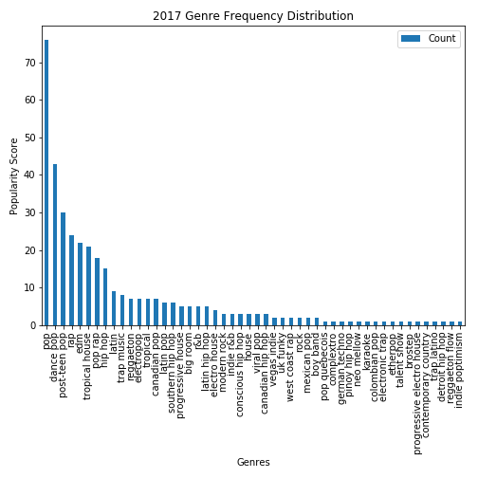
Billboard Top 100 2017

Slide 11
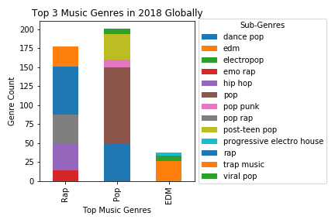
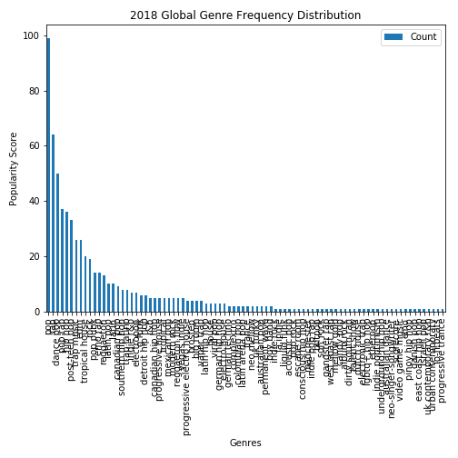
Current Global Music Charts

Slide 12
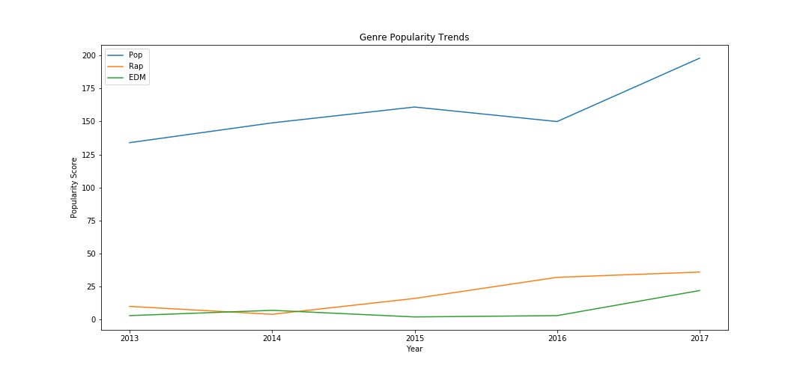
Trend of Music Genres

Slide 13
Some challenges we faced:
Obtaining a good API:
Multiple/no genres:
Years of Music:
Explored the following API’s: MusicxMatch, GraceNote, Spotify, and LastFM. Spotify’s API was the most difficult to use. However, it was up to date with the most recent genres.
Many tracks did not hold specific genres as the genre was labeled by artist.
Spotify’s API held multiple genres per track.
Given that many streaming services are only a few years old, the historical data is limited.
Thus the results are more constrained.
If given two more weeks:
We would also analyze the global top 100 charts in comparison to the US charts.
We would go further back by year and decade to compare with present-day popular music genres.
Notes:
What would we do if we had 2 more weeks:
Global trends
Go further back by year.

Slide 14
Our Findings/Discussion
The music genre, Pop significantly surpassed other genres.
Shown in the frequency distribution charts, approximately 45~50% of the songs on the top 100 charts were included in some “pop” genre/sub-genre.
EDM has been on the rise starting from 2016 .
Rap has been steadily increasing since 2014.
From 2012-2014, the top 3 music genres were: Pop, Rap, & Country.
Starting from 2015-2017, the top 3 genres changed to Pop, Rap, & EDM.
Although rap wasn’t the number one popular genre as expected, it consistently was in the top 3 main genres.
Globally, rap is a lot more popular compared to the US.
Notes:
Hey Austin- the highlighted question: can you elaborate and write down your findings? thanks!!

